Slide 1
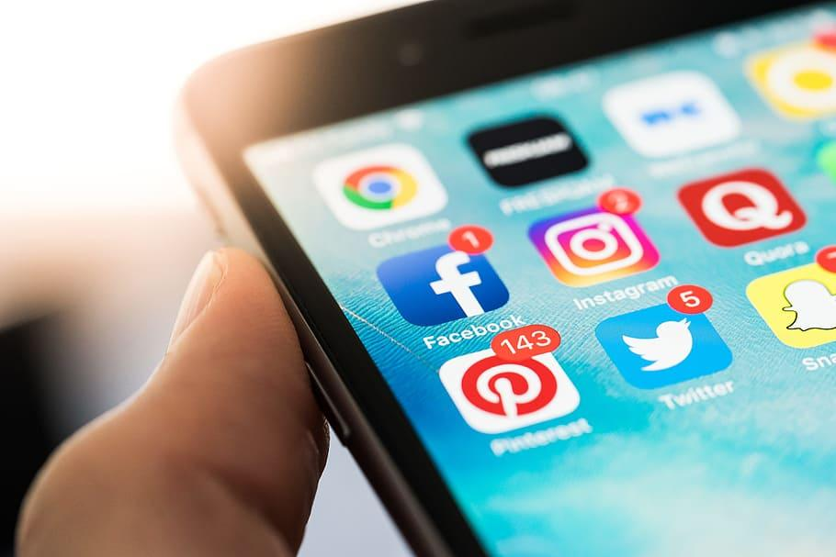
Violence Against Women
Group#3: Madeleine Becker, Kailyn Fuller, Cristina Zorrilla, Emonjanae Mccalister, Cadiene Thompson, Sofia Kratsas, Justin Wildberger

Slide 2
Social Media and Women in General

Slide 3




Today, our lives are heavily influenced by social media sites which include Facebook, Instagram, Twitter, Snapchat etc.
“ The power of the Internet, especially social media, can change the way women value their self-worth, impacting the way we take care of ourselves emotionally, physically, and spiritually” (Witt, 2018).

Slide 4
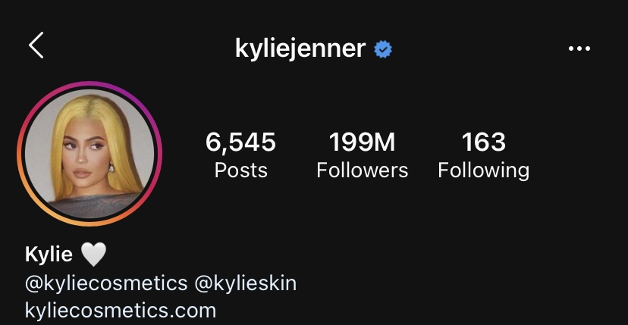
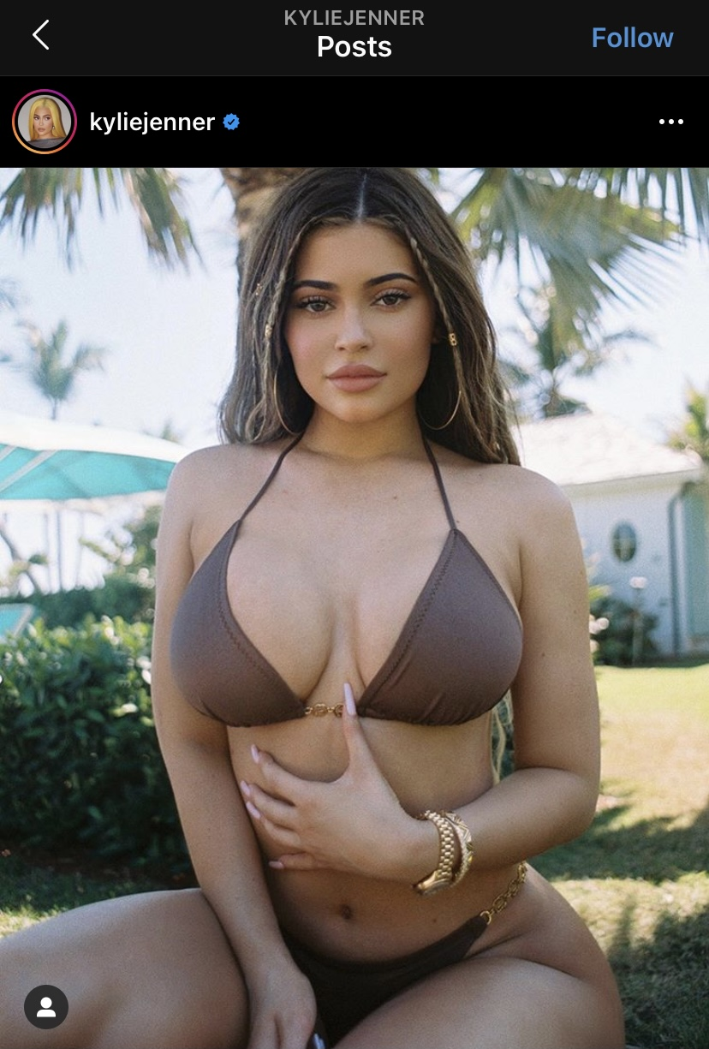
Stereotypes of Women on Social Media
There are millions of girls on social media that have set an unrealistic beauty standard for girls especially the younger generations.
The girls that are setting these standards are often posting photos and videos that enhance on the features they had work done on such as lip fillers, eyelash extensions, botox, etc.
Some may stereotype these women as fake, but the younger generation thinks they need these things in order to be attractive and also become popular on social media.
A modern day example of this would Kylie Jenner’s multiple social media accounts especially because she is the most followed and highest paid social media user. While she does show much of her personality though her social media posting, instead she displays her physical attributes which leads her to be stereotypes as only caring about her looks or to make money

Slide 5
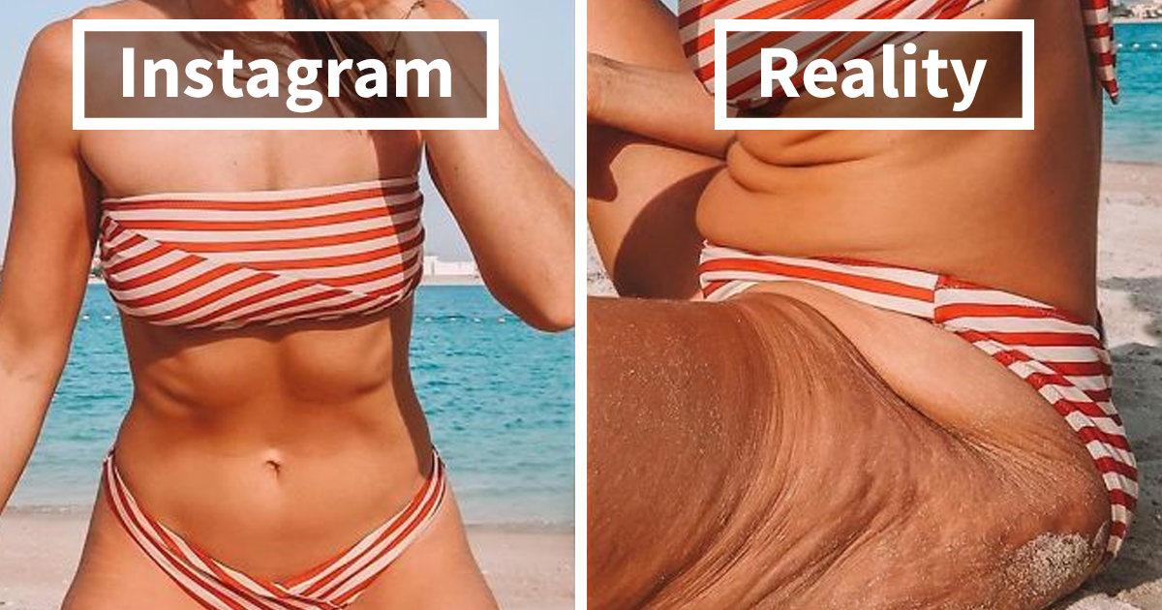
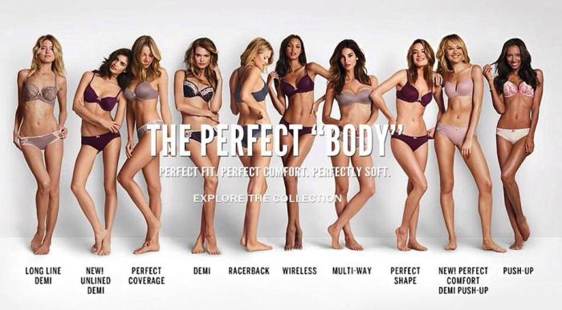
Social Media and Gender Issues
Social media allows women to create their own image of themselves and create their own idea of femininity.
Social media experiences can shape women’s gender construction and self-expectations of sexuality as early as 12 years old” (Garcia- Gomez, 2017).
Social media is typically used to monitor and observe attractive peers as well as celebrities. The problem is girls are seeing these photoshopped images of celebrities and they believe they need to look like them, but it isn’t a realistic image.
Social media perceives the “perfect woman” to be thin with the perfect hair, perfect teeth, and perfect makeup

Slide 6
Sexual Objectification and Self- Objectification
Sexual objectification leads to self-objectification which can eventually cause psychological consequences and mental health risks to women who have become victims.
Sexual objectification is where women are seen as sex objects to sexually plesure men and this is because social media is one of the top places sexual ojectification occurs. Self- objectification is the process where women become used to and accept the beliefs that society frames them to be
“Media exposure spotlights women's bodies and body parts while depicting women as the target of a non-reciprocated male gaze” (Calogero, Tantleff-Dunn, & Thompson, 2011, p. 6). Because of sexual objectification, a lot of women see themselves as sexual objects which often leads them to form a self-consciousness.
The negative effects of self-objectification are usually:
-Depression
- Eating disorders
Fredrickson and Roberts (1977) state that “women’s ongoing efforts to change their body and appearance through diet, exercise, fashion, beauty products, and perhaps most dangerously, surgery and eating disorders, reveal what may be a perpetual and hardly adaptive body-based shame, which results from a fusion of negative self- evaluation with the potential for social exposure” (p. 181).
Body shame
Anxiety

Slide 7
Conversation US
Conversation US did a research study to prove that sexual objectification leads women to self-objectification and that it harms their emotional well- being.
Research:
Asked 268 women that were aged 18-46 in Melbourne and St. Louis and had them download an app to their phones
Several times a day the app would have them rate their emotions, how preoccupied they were with their physical appearance, and if they had recently been targeted by sexually objectifying behavior or have witnessed that behavior towards another woman.
They chose this research method so that they can:
1.) Be sure to capture “real world” examples of sexual objectification
2.) Instead of relying on potentially unreliable memories of past events & feelings recorded in surveys or journals, by using smartphone surveys they could gather more accurate “real time” reports of sexual objectification
3.) Repeatedly sampling women’s daily experiences enabled us to observe the psychological processes triggered by sexual objectification

Slide 8
Conversation US - Continuation
Findings
“More than 65% of women in our study were personally targeted by sexually objectifying behaviour at least once during the monitoring period. This might have included being ogled, catcalled or whistled at.
Our findings were consistent with Fredrickson and Roberts’s theory: women reported being preoccupied with their physical appearance roughly 40% more when they had recently been targeted by sexually objectifying behaviours, compared to when they had not.
Importantly, these momentary spikes in self-objectification predicted subsequent increases in women’s negative emotions, particularly feelings of shame and embarrassment.
Although these increases were small, they were reliable, and appear to be indirectly caused by exposure to sexually objectifying behaviours.”
https://theconversation.com/sexually-objectifying-women-leads-women-to-objectify-themselves-and-harms-emotional-well-being-120762

Slide 9
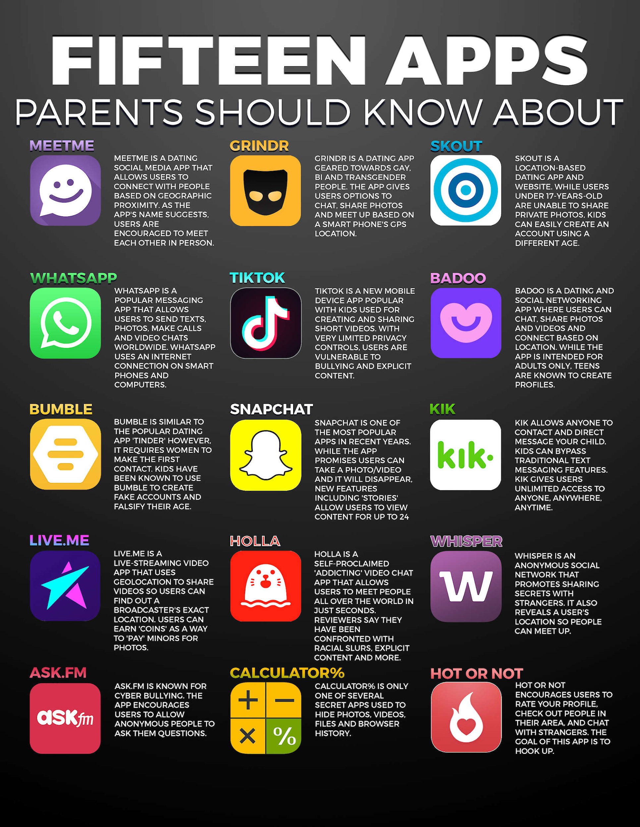
The younger generation of girls is so obsessed with having a big social media following, posting perfect content, and showing off. The younger you are the more vulnerable you are, which can lead to dangerous scenarios.
Reasons why this is dangerous are :
Posting too much and showing your location can be easy for human traffickers to find out where you are
People could act as someone they aren’t and message you and then groom you for personal information
Someone could use your posts and pretend to be you which can lead to your face being associated with messages or content you would not send

Slide 10

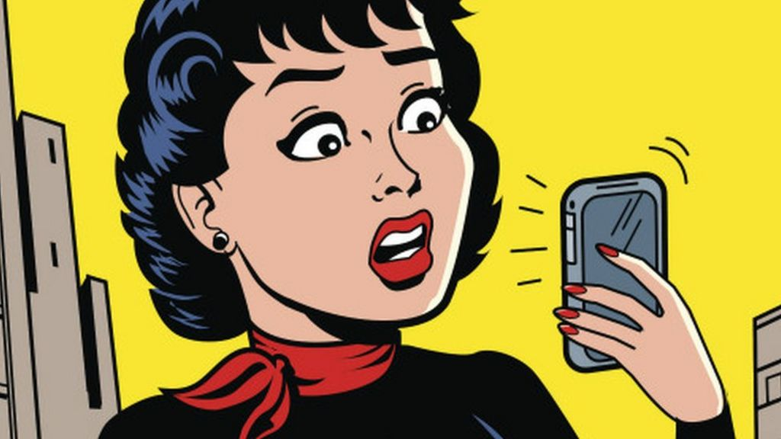
Types of Violence Against Women from Social Media
Threats
59% of women who experience abuse or harassment said the perpetrators were completely strangers.
Threat of violence. Such as death threats.
Public shaming (embarrassing photos, videos, or comments)
Gendered slurs/ name calling
Privacy Violations
Revenge porn is the distribution of sexually explicit images or videos of an individual without their consent.
90% of revenge porn victims are women.
Revenge porn victims are often harassed or stalked outside of the internet by users that have seen the material online.
Some of the effects of revenge porn are PTSD, anxiety, and depression.
Stalking and Harassment
According to womenshealth.org “about one in six women has experienced stalking in her lifetime. Women are twice as likely to be stalked as men are.”
Women receive unwanted and obscene photos and messages that are often sexual in nature.
Women are often Cyber Stalked and harassed by past lovers
Cyber Stalking can easily turn into in-person stalking

Slide 11
Instagram and its Effects on Women Today
By: Madeleine Becker

Slide 12
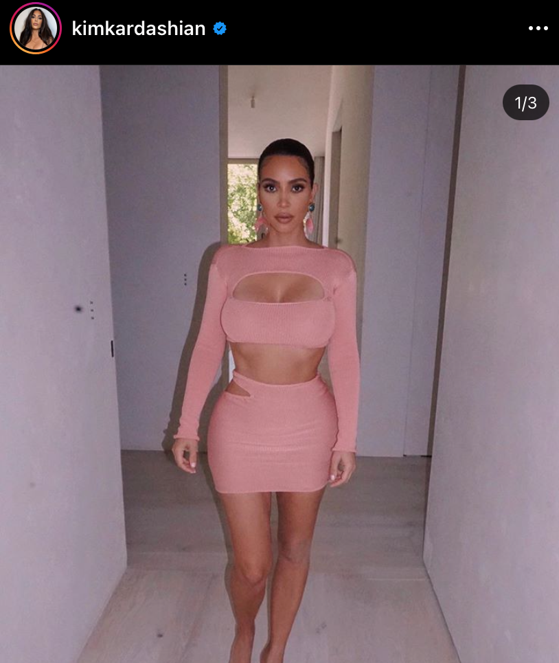
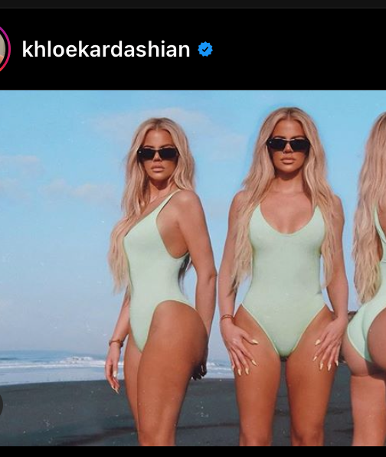
Stereotypes of Women on Instagram
Women on Instagram post pictures with their makeup fully done, hair perfect, and their bodies immaculately captured with all the right angles and lighting.
With these single pictures posted on the internet for all their followers to see, it is hard to deny the fact that many people believe they must look like this all the time.
When looking at say, for example, the Kardashian’s Instagram profiles, it is obvious that they always have their makeup done, hair perfectly done, and they are always sporting pictures glamorously with their perfectly lit faces and bodies.
Right image is a screenshot from Kim Kardashian’s Instagram. This picture is of her with her perfect makeup and outfit sporting her feminine figure. Left image is a screenshot from Khloe Kardashian’s Instagram. She is showing off all angles of her body in her one-piece bathing suit showing her curvy figure.

Slide 13
Societal Standards
Some believe this is what every women should be like or look like, in fact, many women believe that they should always look perfect and try to achieve this sense of perfection for their followers on Instagram and other social media. The stereotype of having the perfect makeup, slim waist, and big breasts is a common one and usually believed to be the most feminine a woman can be. It is usually expected of women to achieve this. It has come to the point where women that do not fit this idea of “perfection” post on Instagram, there is backlash and bullying towards these women.
Whether it is weight or looks. Heavier women do not get treated the same way that “thinner” women are treated, and this is because of body-shaming and the stereotypical women idea that has been implanted into our minds when it comes to social media. Heavier women are told they are “ugly” , “fat” , “need to work out” , “put on makeup” , “cover up”, these hateful things towards women who don’t meet the societal standards of “beauty” and it is detrimental to the well-being of these women.

Slide 14
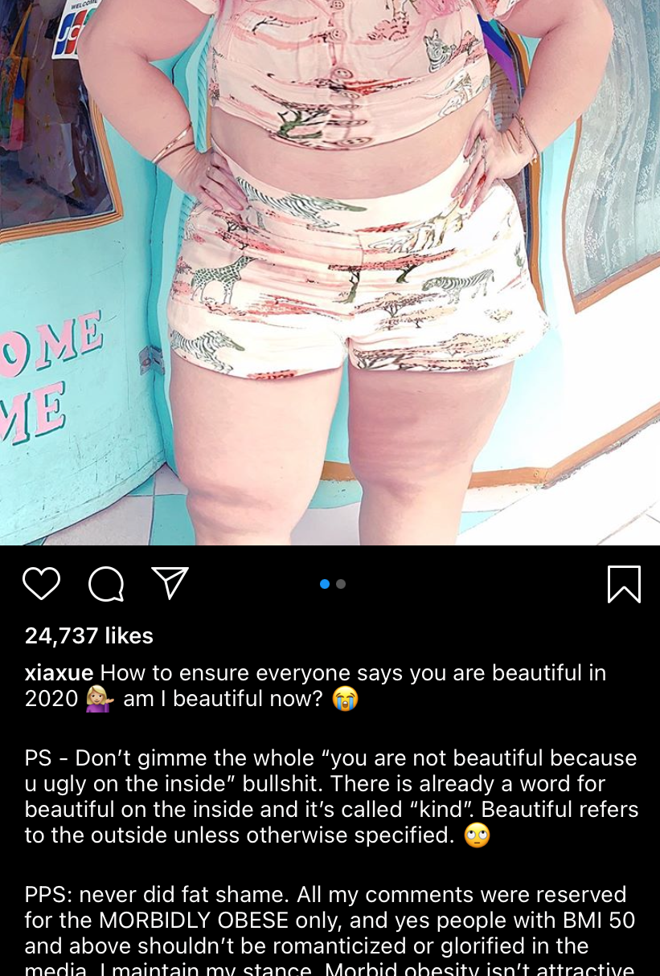
Body-shaming Influencers
Wendy Cheng, who goes by the name Xiaxue on Instagram and YouTube with a combined 850,000 followers and is famous online for her beauty tutorials and cosmetics tips, and universal posts about her life in Singapore.
Cheng began earning attention for another reason, which began after a string of posts about model La’Shaunae Steward. The comments, shared on Cheng’s Instagram stories, called Steward “disgusting,” “morbidly obese” and “irresponsible” for promoting an unhealthy lifestyle.
On Feb. 17, the influencer shared a photoshopped image of herself to Instagram, which transposed her face onto a heavier body.

Slide 15
Fitness model and influencer Jem Wolfie says that body-shaming is an “everyday thing” for her, as she has over millions of followers on Instagram.
“It can be exhausting to have negativity constantly shoved down your throat every day,” she told LADbible. "Why would someone get mad about what I do for a living?” she told LADbible. “The only reason why someone would get mad at what I do for a living is 'cause their butt hurts 'cause they sit in an office all day,” she said.
Body shaming or plain bullying is something very prominent on social media nowadays since everyone always has something to say and they don’t believe what they’re saying is going to impact the way the person feels, such as a famous influencer who deals with it everyday. Everyone's idea of “healthy” is different.
https://www.foxnews.com/lifestyle/instagram-model-jem-wolfie-body-shaming-exhausting

Slide 16
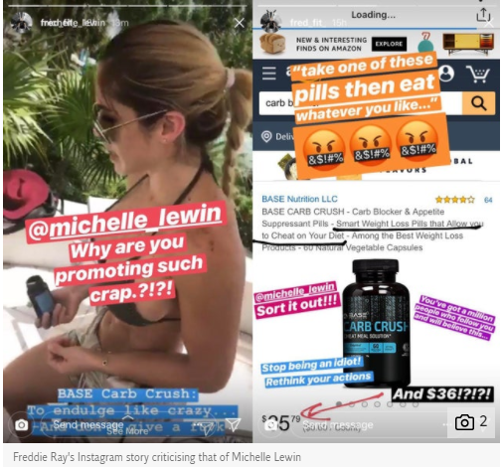
Weight Loss Promoting
A fitness influencer named Michelle Lewin with 13 million followers was slated for promoting “extremely dangerous” weight loss pills that claim to “allow you to cheat on your diet.” She is a fitness model as well as a bodybuilder.
She posted a picture on her Instagram story of her holding Base Carb Crush pills “To indulge like crazy… And don't give a f*** [sic].” The post linked to an Amazon page selling the “cheat meal solution” pills, which are marketed as “carb blockers” and “appetite suppressants” that “allow you to cheat on your diet.” The full ingredients of the product is not listed.
She has been extensively disparaged for promoting a harmful approach to food as well as carbs.

Slide 17
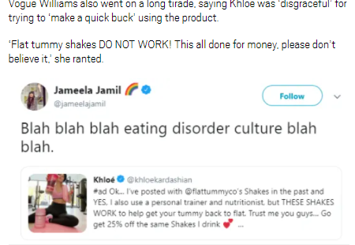
Other products such as weight loss shakes and hunger suppressants such as lollipops have been promoted by famous influencers such as, guess who, the Kardashians.
The original post by Khloe on Instagram was taken down after the backlash it received. Khloe posed in active wear while holding up the brand’s powder in one hand and a shake in the other in the controversial snap. She captioned it: “Okay… LISTEN UP. I’ve posted with @flattummyco’s shakes many times in the past and YES, I also use a personal trainer and a nutritionist.” She claimed that the shakes do in fact work.
It’s not the first time Khloe – along with other members of the Kardashian family – has faced backlash for advertising a range of weight loss products on social media, including detox teas, appetite-suppressing lollipops and waist trainers.
In this screenshot, celeb Jameela Jamil blasted Khloe.

Slide 18
Twitter and its Effects on Women Today
By: Emonjanae Mccalister

Slide 19
Violence Against Women: Twitter
Most women tend to use Twitter and other forms of social media as means of an outlet to voice their opinions on the many different things that women tend to go through such as rape, slut shaming, domestic violence, and many other violence against women. Most women also use Twitter to speak on sexual assaults that happened to them whether it be recent or from the past, and in doing so they have let the public assume what they want about their situations and in turn using it against them, such as saying they “asked for it,” or they “could’ve done more” to prevent it from happening or even “maybe if you weren’t wearing… it wouldn’t have happened,” and many other ignorant comments. When speaking on their sexual assaults they’re using Twitter solely to put the information out their and to keep people informed on what actually happens but instead they’re faced with rude and ignorant people who think they know their situation, or that it’s “not real” instead of just reading or even just scrolling past if it’s not something you care about or care to put interest in.

Slide 20
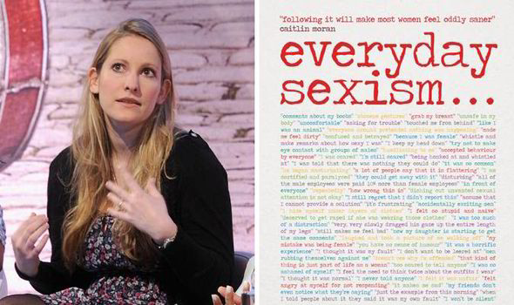
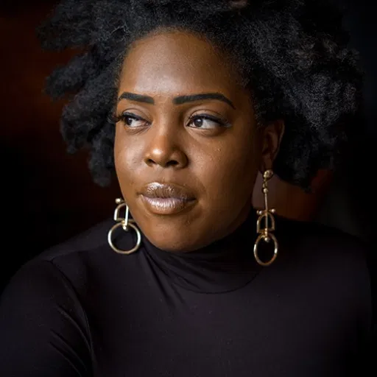
Examples
There are many examples of the violence that women face on Twitter such as:
Laura Bates, she’s a human rights activists and writer from the UK and she created the Everyday Sexism Project, and when she created that project, she received many abusive threats from people saying they’ll rape her.
Danielle Dash a UK writer who would receive abusive threats saying that they’ll rape her and calling her names because of her skin color.
Women face many different types of violence when it comes to how they look, what they do, or what they even post online, solely because they stand up for women and believe in human rights so they’ll receive threats going against everything that they’re fighting for.

Slide 21
Toxic Twitter’s Oppression Against Women
Twitter has been deemed “Toxic Twitter” due to all the alarming threats that get sent through Twitter, and the freedom that many people feel they have and that they can say without having to worry about being reprimanded. There has been findings that there are 1.1 million abusive tweets being sent out to women calculating out to 778 women receiving them and while they’re being received, a new one is being sent out every 30 seconds. Black women are also 84% more likely to receive these threats over white women but within receiving these threats they are also racial slurs throwing in which adds fuel to the fire or in this case piling on more abuse for the victim.
Amnesty did an online poll and within the poll it was reported that 29% of women receive threats involving sexual or physical violence in the USA and in the UK 27% of women received these threats.

Slide 22
Stereotypes
When you get on Twitter the first thing you see are many different tweets from your different followers and people you are following but in doing this you also start to see the unrealistic expectations of women all down your timeline. It usually tends to be the typical light skin girl with curly hair, a small waist, and either skinny, or a big butt and chest but with no stomach and no stretch marks. By flooding a timeline with this you’re pretty much forced to see everything that you may not be and what you may want to be and by throwing it in your face and seeing all of the comments of everyone going crazy or the basics makes you realize the unrealistic expectations that people tend to have over women and how they should or shouldn’t look.

Slide 23
Twitter has given many people a voice some to use for good while others to use for bad, and the fact that women can’t even feel safe on social media and speak out, and use their voices to bring awareness to the different obstacles and oppression that women face is disturbing, around 42% of women in the USA and 36% of women in the UK feel threatened offline, and that shouldn’t be the case a women should be able to speak out without having to worry about if she walks outside someone will come up and rape her, or sexual assault her. A woman shouldn’t have to fear for her safety all because she’s standing up for something she believes in and something that is humanly right.
Sources:
•Toxic Twitter - Women’s Experiences of Violence and Abuse on Twitter. (2018). Amnesty International. https://www.amnesty.org/en/latest/research/2018/03/online-violence-against-women-chapter-3/
•Why Twitter is a toxic place for women. (2018). Amnesty International. https://www.amnesty.org/en/latest/research/2018/03/online-violence-against-women-chapter-1/
•Haynes, S. (2018, December 18). “A Toxic Place for Women.” A New Study Reveals the Scale of Abuse on Twitter. Time. https://time.com/5482390/twitter-online-abuse-women-amnesty-international-study/

Slide 24

Facebook and its Effects on Women Today
By: Cristina Zorrilla

Slide 25
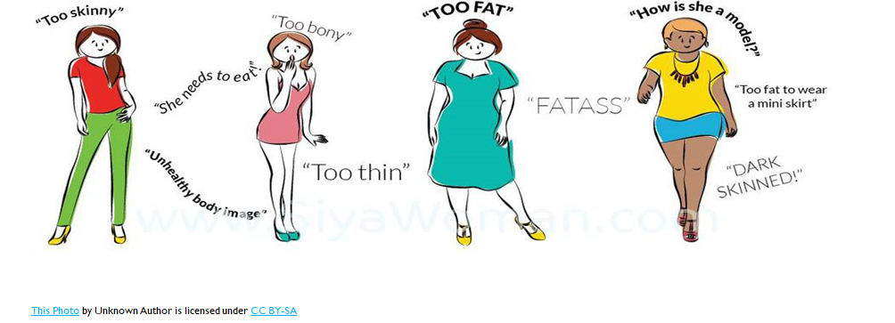
•Facebook is a social outlet that has more than 2.7 billion users from all around the globe which makes it almost impossible to not have any problems with victim shaming. Many women are used to body shame, harass, and bully through this source. There have even been incidents where people will post a woman doing sexual activities resulting in the company having to put strict guidelines to stop such behaviors. Not only is this torture and unjust for the victim, but it may be dishonoring in certain countries like India.

Slide 26
Facebook Victims
•One woman in December searched and found a group named “Men are better than women” that would post pictures of women beat up and bloody with distasteful comments such as “she should be raped”. After reporting this group to facebook, they didn’t take it down because they didn’t see any wrongdoing by the people. They even posted her and edited her picture to have blood and more nasty comments. The group members claimed it was humorous and it wasn’t until the woman went public with the situation that facebook finally took action. The victim’s name was Thorlaug Agustsdottir.

Slide 27


Facebook Victims
•16 year old Jada from Texas was a victim of on facebook. She was at a house party with friends from school and got drunk and raped. The next day she realized she had pictures of her unconscious and in weird positions and people were making fun of her and calling her poses the #jadapose.
•An Indian girl was also a victim on facebook being exposed to getting gang raped and having one of the men point at her with a gun and videotape her. She was scared and devastated thinking about how this would affect her and her family.

Slide 28
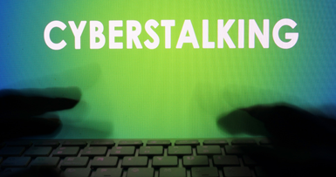
•Stalking is also a popular form of violence. On the web, you don’t know who is constantly viewing your page and usually it is ex partners involved in this. One researcher stated, “On the front line of domestic violence prevention, Australian women’s centre workers have observed increasing numbers of women who have been harassed, stalked and found through Facebook” (Susan Hopkins, 2015).
•Exploitation has played a big part in facebook. A lot of these incidents are from ex partners that want to get revenge and decide to post intimate pictures that were taken in privacy or when they were together.

Slide 29
Facebook has so many different new things happening every time there is an upgrade. For example, being Live and just recording what people are doing as if doing a broadcast. Comments can come floating in and after the person stops recording, friends and others that missed it live can still see the whole recording. With so many different ways to post things and so many users all throughout the world, one could only expect the delay in which facebook officials will take to take down inappropriate posts. Women have to defend themselves offline in the real world, and online where people who they don’t even know can post about them. They have to worry about stalkers, harassers, stereotypes, cyberbullies, and so on. People have created groups that have disgusting posts about women with edited photos and showing sexual body parts without the woman’s consent. Facebook has precautions that give users the options to report groups and people who they believe are a threat but is blocking someone really enough? Does it always have to get publicized and have out into the news for Facebook to react? How long do women have to accept the ugly, intimate media that others put out their about women for it to be noticed?
Resources:
CATHERINE BUNI, S. C. (2014, October 9). The Unsafety Net: How Social Media Turned Against Women. Retrieved from The Atlantic: https://www.theatlantic.com/technology/archive/2014/10/the-unsafety-net-how-social-media-turned-against-women/381261/
Susan Hopkins, J. O. (2015, November 29). Domestic violence and Facebook: harassment takes new forms in the social media age. Retrieved from The Conversation: https://theconversation.com/domestic-violence-and-facebook-harassment-takes-new-forms-in-the-social-media-age-50855

Slide 30
Snapchat and its Effects on Women Today
By: Justin Wildberger

Slide 31

Sexism Caused by Snapchat
Snapchat provides cover to potential sexual predators by allowing users to send and receive messages that are automatically deleted after being seen/read. Users are only required to be 13 to sign up and their actual age is unverified beyond entering a birthdate, so many will be even younger than 13. This opens the platform up to abuse by pedophiles seeking to harass underage girls.
“Snaps” (pictures and messages sent on Snapchat) do not necessarily disappear, as the recipient can take a screenshot of the message. Unless the recipient is using a third party app to take screenshots, the sender will be informed. By that point it will be too late, and the recipient will have a permanent copy of whatever was sent.

Slide 32
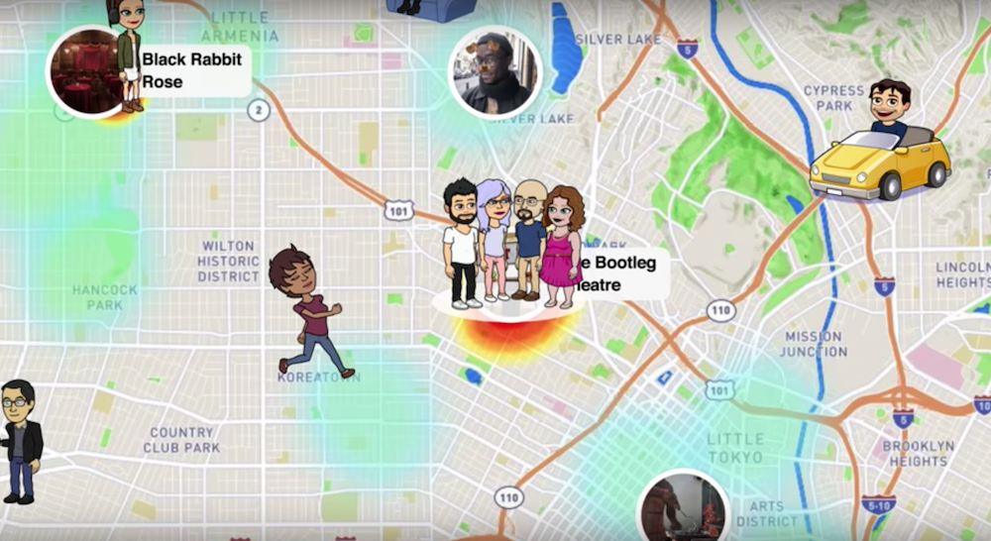
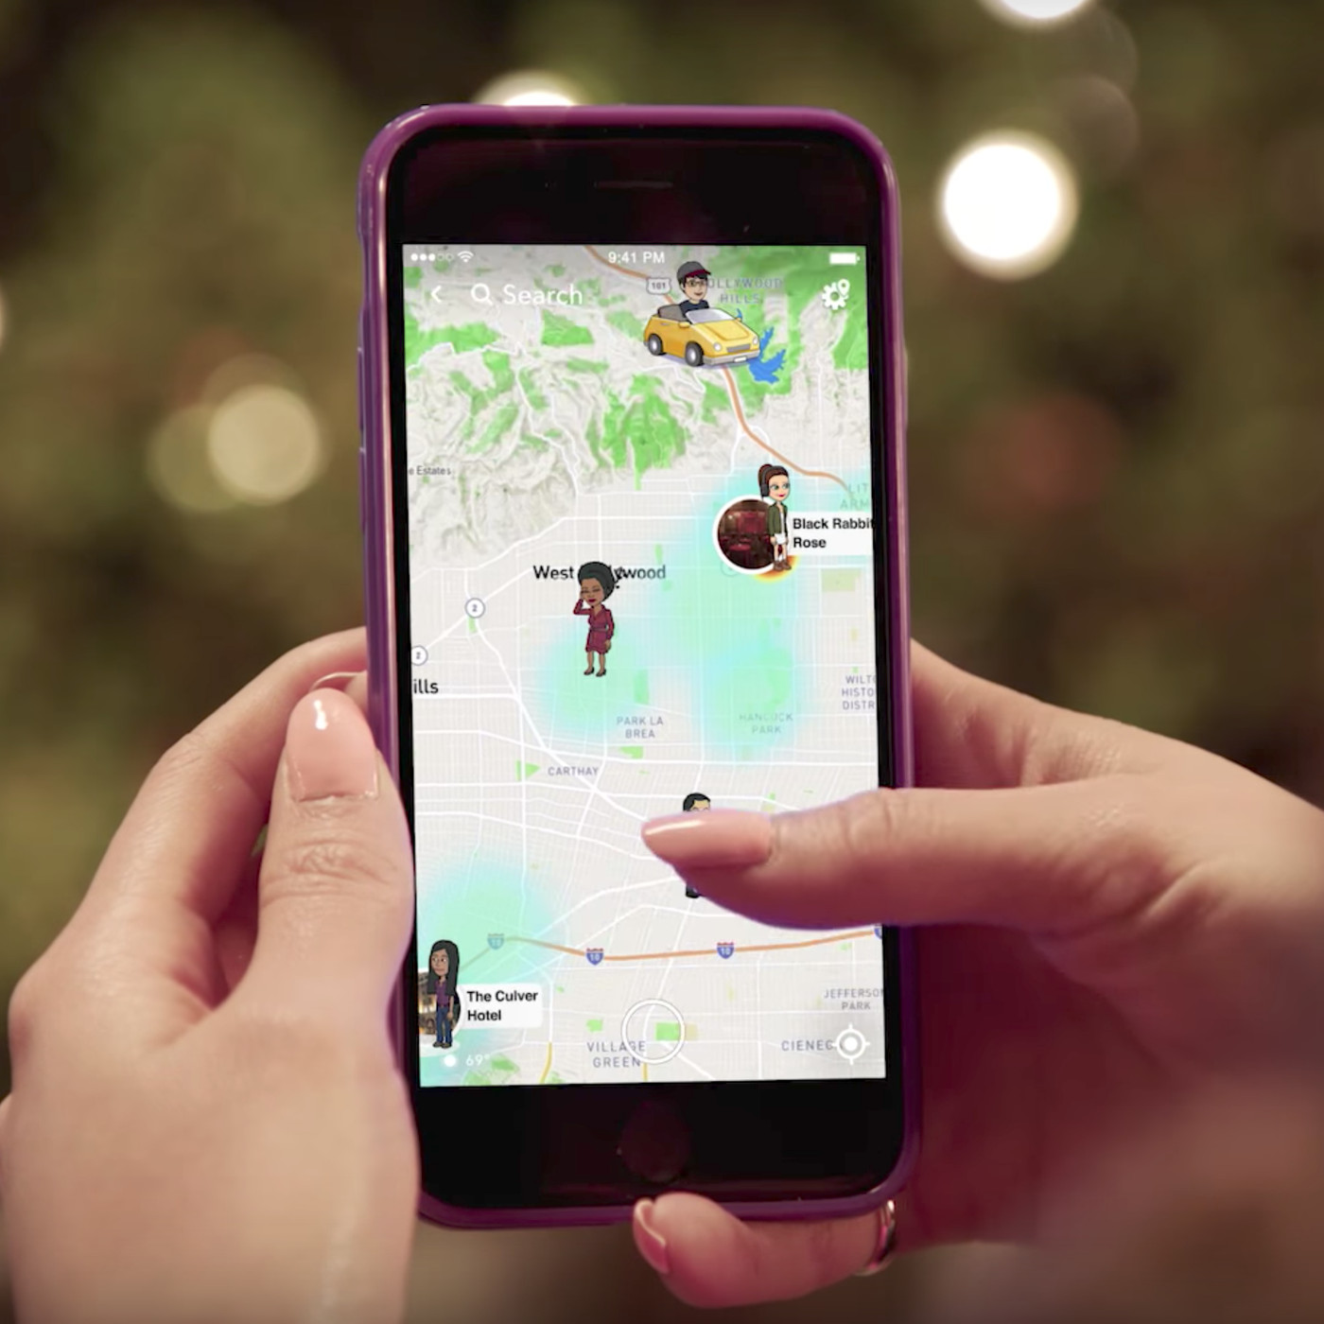
“Snap Map” is a feature within Snapchat that shows a user’s location in real time to all of their friends that wish to view it. While this feature is optional, it is possible that young women will not recognize the danger of everyone in their friends list knowing their exact location, especially because the word friend in friends list is loosely defined here. Often, users do not know many of the people in their friends list (Elgersma, 2018).
Snapchat makes it simple to find and add friends that a user may know little to nothing about. This in itself is dangerous as it opens a line of communication with people that have unknown intentions and allows them to view potentially sensitive information, such as location (Elgersma, 2018).
(Elgersma, C. (2018, June 18). Everything you need to know about Snapchat. Retrieved October 29, 2020, from https://phys.org/news/2018-06-snapchat.html)

Slide 33
In 2019, Snapchat introduced a new photo filter that claimed to change a user’s facial features to
resemble the opposite gender, which obviously required some assumptions on the part of Snapchat
concerning what a woman “should” look like. The filter smoothed a user’s skin, lengthened their hair,
and applied heavy makeup, creating as close an approximation of a woman as possible – in the opinion
of the application’s developers. A filter that attempts to distill an entire gender into a single set of
characteristics must obviously rely on stereotypes, which the “gender-swap” filter did. This also plays
into the narrative that women that do not fit into this box are somehow flawed or less attractive.
(Anderson, S. (2019, May 16). Snapchat&#39;s &#39;gender-swap&#39; filter exposes the internet&#39;s casual transphobia. Retrieved October 28, 2020, from https://mashable.com/article/snapchat-gender-swap-filter/)

Slide 34
Sexism Within Snapchat
There have been fairly widespread reports of sexism inside Snapchat. Emails from CEO Evan Spiegel were released in 2014, in which he “encouraged fellow members of Kappa Sigma at Stanford University in Palo Alto, Calif., to receive as much oral sex from women as possible.” Also, Spiegel “offered a blunt to whoever saw the most breasts in one night,” along with a number of other incredibly sexist comments (Waxman, 2014).
(Waxman, O. B. (2014, May 29). Snapchat CEO Evan Spiegel apologizes for frat emails.Retrieved October 29, 2020, from https://time.com/134576/snapchat-ceo-apologizes-for-explicit-frat-emails/)

Slide 35
In 2018, Snapchat parent company Snap engineer Shannon Lubetich went public with accusations that the company was “fostering a ‘sexist’ and ‘toxic’ workplace culture.” The company did not deny the accusations, instead offering to work towards remedying the issues raised (Statt, 2018).
Snap released diversity figures for the first time that showed the extent of gender differences within the company. Only 13 percent of its technical workforce and 22 percent of upper management consisted of female employees, lagging behind even other notoriously sexist social media companies such as Facebook and Twitter (Statt, 2018).
(Statt, N. (2018, May 29). Former Snap employee says company has a &#39;toxic&#39; and &#39;sexist&#39; culture. Retrieved October 28, 2020, from https://www.theverge.com/2018/5/29/17406524/snapchat-sexist-toxic-workplace-culture- diversity-numbers-report)

Slide 36
In summer 2017, at a party celebrating Snapchat’s sixth anniversary hosted by co-founders Evan
Spiegel and Bobby Murphy, the company hired women in scantily clad outfits meant to resemble
one of the many Snapchat photo filters to hand out appetizers and serve as entertainment.
Several employees, including vice president of communication Mary Ritti and engineer Shannon
Lubetich, later said that they felt uncomfortable with the models at the party (Heath, 2019).
Lubetich recalled witnessing “overly macho competitions and male-dominated turf wars between
managers and their departments,” which only contributed to the “pervading sexist vibe” within
the company (Heath, 2019).
Heath, A. (2019, July 18). Former Snap employee questions company&#39;s culture and diversity.
Retrieved October 28, 2020, from https://cheddar.com/media/inside-snap-employee-
concerns-raise-questions-about-culture-and-diversity

Slide 37
References
Anderson, S. (2019, May 16). Snapchat&#39;s &#39;gender-swap&#39; filter exposes the internet&#39;s casual
transphobia. Retrieved October 28, 2020, from https://mashable.com/article/snapchat-
gender-swap-filter/
Elgersma, C. (2018, June 18). Everything you need to know about Snapchat. Retrieved October
29, 2020, from https://phys.org/news/2018-06-snapchat.html
Heath, A. (2019, July 18). Former Snap employee questions company&#39;s culture and diversity.
Retrieved October 28, 2020, from https://cheddar.com/media/inside-snap-employee-
Concerns-raise-questions-about-culture-and-diversity
Hinduja, S., &amp; Patchin, J. W. (2015). Bullying beyond the schoolyard: Preventing and
responding to cyberbullying. Thousand Oaks, CA: Corwin.
Statt, N. (2018, May 29). Former Snap employee says company has a &#39;toxic&#39; and &#39;sexist&#39; culture.
Retrieved October 28, 2020, from
https://www.theverge.com/2018/5/29/17406524/snapchat-sexist-toxic-workplace-culture-
Diversity-numbers-report
Waxman, O. B. (2014, May 29). Snapchat CEO Evan Spiegel apologizes for frat emails.
Retrieved October 29, 2020, from https://time.com/134576/snapchat-ceo-apologizes-for-
explicit-frat-emails/

